Slide 1
The Communication Cycle

Slide 2
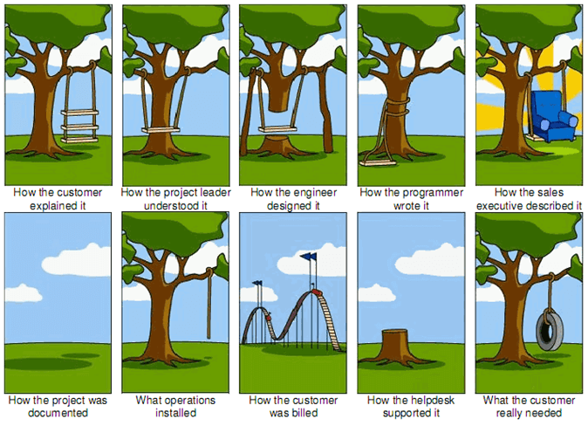

Slide 3
A young executive is leaving the office late one evening, when he finds the CEO standing in front of a shredder with a piece of paper in his hand.
"Listen," says the CEO, "this is a very sensitive and important document here, and my secretary has gone for the night. Can you make this thing work for me?"
"Sure," the young executive says.
He turns the machine on, inserts the paper, and presses the start button.
"Excellent, excellent!" says the CEO as his paper disappears inside the machine. "I just need one copy."

Slide 4
The Communication Process
Two-way process of reaching mutual understanding, in which participants not only exchange information and feelings but also create and share meaning.
Different modes could be used; the message could be simple or complex.
The underlying structure or communication cycle remains the same.

Slide 5
8 Components of Communication Cycle
Sender
Message
Encode
Channel
Receiver
Decode
Feedback
Noise/ Barriers

Slide 6
Initiating the Communication Cycle
For a message to be transmitted and received, it must go through six stages:
AIMING
ENCODING
TRANSMISSION
RECEIVING
DECODING
Feedback

Slide 7
AIM
Recipient: During this stage, you decide to initiate communication with your chosen receiver.
Content: Decide what you want to communicate.
Medium: What medium you want.
consider this

Slide 8
2. Encoding
This stage is when you choose the words and images to express the content of your message.
Objective is to choose the words and images which will give your message the best chance of being understood.
Your choice of language is influenced by your assumptions, experiences, gender, education, and even your moods.

Slide 9
3. Transmission
The transmission stage is when you choose an appropriate means to transmit your message
objective is to identify the medium and conditions that will enable the clear reception of your communication
make sure that you select the best place and time to deliver your information
consider this.docx

Slide 10
Three Steps to Success
Before you speak, ask yourself:
Is the time right to communicate this?
Will the receiver hear what I'm saying?
What distractions might make communication difficult? Can they be avoided?

Slide 11
4. Receive: During this stage, your recipient physically receives your message. In face-to-face contact, the verbal and vocal content of your message is received aurally. Your body language is received visually.
5. Decode: During this stage, the receiver translates what has been seen and heard. He gains a personal understanding of each message.

Slide 12
Closing the Loop
Feedback:
Effective communication is a two-way process.
A message has not been effectively transmitted unless it is received and understood by the person it was sent to.
The only way that senders can know this has occurred is from response or feedback.
To complete the cycle, the receivers must become the senders. In other words, they send feedback.

Slide 14
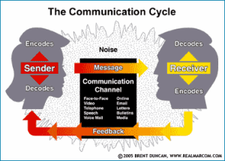

Slide 15
Overcoming the Barriers
Effectiveness of communication is determined by the psychological, relational, environmental, and cultural conditions in which it takes place.
If these are not favorable, they can create barriers to good communication.

Slide 16
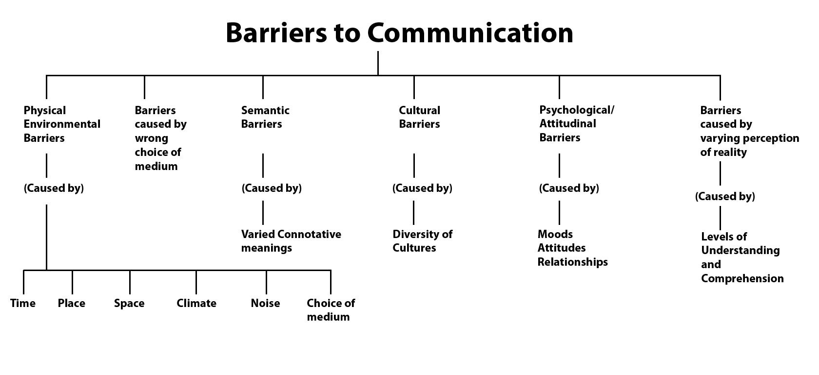

Slide 17
7Cs of Effective Communication
Clarity: Know the purpose to ensure that we express ourselves clearly. should use accurate and familiar words with proper intonation and pauses. Make your key messages standout
Concreteness: be specific in defining things. Avoid repetitions, using vague words, passive voice
Correctness: grammatical and factual correctness is needed in establishing credibility and trust.
Coherence: communication should be logical. All points should be connected and relevant.

Slide 18
Conciseness: Being able to convey the message in minimum words. Helps in
saving time, in underlining the main message
Avoid being repetitive
Give a single word for these wordy phrases:
At this point of time….
As regards the fact that….
Because of the fact that…..
Are in need of…..
In due course of time…..
Not very far from here…..

Slide 19
Completeness: should convey all facts necessary for understanding the message
It is essential that presentations, discussions or dialogues should be well planned and structured.
Courtesy: maintaining proper decorum
Don’t use words that hurt or insult or mock people
Listen patiently; don’t interrupt
Notes:
Friendly and helpful behavior towards others
Thank generously for a favor
Apologize promptly and sincerely
Avoid irritating expressions
Answer all letters/questions
Use empathy
Polite manners facilitate participative communication

Slide 20
Example 1
Tenerife is a prime example of ambiguity’s affect on aviation safety. When the KLM pilot told ATC that they were taking off ATC replied ‘OK.’ Having taken this to mean you can take off, KLM took off colliding with a Pan Am aircraft that was taxiing on the runway as a result 583 people were killed. It is true that if you look closer into the accident the air traffic controller followed OK with “standby for takeoff, I will call you”, this was lost in radio static due to disturbance.

Slide 21
The following anecdote is a reminder of how our thoughts, assumptions and perceptions shape our own realities:
A traveller was walking down a road when he met a man from the next town. "Excuse me," he said. "I am hoping to stay in the next town tonight. Can you tell me what the townspeople are like?"
"Well," said the townsman, "how did you find the people in the last town you visited?"
"Oh, they were a quick-tempered bunch. Kept to themselves. Took me for a fool. Over-charged me for what I got. Gave me very poor service."
"Well, then," said the townsman, "you'll find them pretty much the same here."

Slide 22
The Chief Power Engineer,
An international conference on power generation which would be of great interest to us is being held in Chennai. The enclosed brochure shows that the conference would be of great help in our upcoming projects. The registration fee is just Rs. 5,000. I am informing you about the conference now, so that you can take a decision in time for me to make necessary arrangements for travel and stay.
Vinay Prasad

Slide 23
Vinay Prasad,
Thanks for informing me about the conference in Chennai. I will certainly attend it. Please make all the necessary arrangements for me as suggested in your letter.
Ashok Jha

Slide 24
Lynnette has worked hard to find a lost shipment. She finally has enough information to email the customer and provide an update on the situation. She begins writing up her draft:
“You won’t believe how many people I had to contact to find this for you. I had to call Texas, send a copy to Dallas, and then…..”

Slide 25
Writing for the reader: You attitude
Lynette should write, “Your product is scheduled for delivery March 30. Your product was in the Texas depot.”
Put the receiver’s needs before the sender’s needs
Start with what the receiver needs to know

Slide 26
She sells seashells by the seashore on a shiny Sunday

Slide 27
Can you can a can as a canner can can a can?

Slide 28
I have got a date at a quarter to eight; I’ll see you at the gate, so don’t be late

Slide 29
Betty Botter bought some butter But the butter was bitter So it was better Betty Botter bought a bit of better butter

Slide 30
How much wood would a woodchuck chuck if a woodchuck could chuck wood? He would chuck as much as he could, and chuck as much wood As a woodchuck would if a woodchuck could chuck wood

Slide 31
Supercalifragilisticexpialidocious?

